Slide 1
Education

Slide 2
Wolfram|Alpha in the Classroom
Engaging Enriching Entertaining
Notes:
Reference Library
= real-time data
Scientific Calculator
= w/ show steps,
STEM Learning Tool
= promotes socratic thinking and “inquiry based learning”
= Algebra crisis
Socratic Learning
= the question becomes more important than the answer, student driven/centered learning

Slide 3
Webinar Objectives
What is Wolfram|Alpha?
Products
Content
Integrating Wolfram|Alpha into the classroom
Educational Features
Wolfram|Alpha Demo
Widget Builder Demo

Slide 4
Wolfram|Alpha is a Knowledge engine
Natural Language
Dynamic Computation
Curated Data
Computational
Aesthetics

Slide 5
Wolfram|Alpha versus Google & Wikipedia
Google
Searches URLs
Thousands of results
Wikipedia
Community generated
Subjective, descriptive results
Wolfram|Alpha results are computed by robust algorithms mapped to over 10 trillion pieces of data

Slide 6
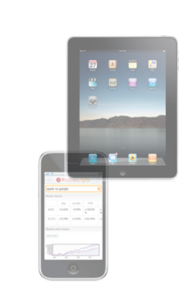
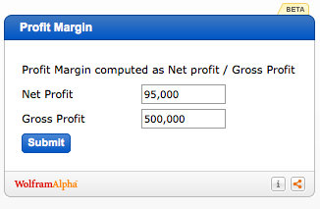
Products
Wolfram|Alpha Website
www.wolframalpha.com
Wolfram|Alpha App for Smartphones
Learning at your fingertips!
Widget Builder
http://developer.wolframalpha.com/widgets/
A mini-app built on a W|A query
Wolfram|Alpha API
Tools for partners to leverage W|A engine

Slide 7
Wolfram|Alpha in the Classroom
Engaging Enriching Entertaining
Notes:
Reference Library
= real-time data
Scientific Calculator
= w/ show steps,
STEM Learning Tool
= promotes socratic thinking and “inquiry based learning”
= Algebra crisis
Socratic Learning
= the question becomes more important than the answer, student driven/centered learning

Slide 8
Content
Mathematics
Arithmetic, Algebra, Geometry, Calculus, Trigonometry, Prob and Stats
Science
Earth Science, Life Science, Biology, Chemistry, Physics, Astronomy
Social Sciences
Socioeconomics, Finance, Geography, History, Education
And more!
Engineering, Computational Science, Music, Food and Nutrition, Culture and Media
For a comprehensive list go to…
http://www.wolframalpha.com/examples/
Hisotry Geography
ISS INSAT-1D
AAGCTAGCTAGC
Silver, gold
Tides, Seattle 3pm tomorrow
History/Geography
President of Mexico in 1950
Sydney, Australia to Los Angeles, California
English
Synonyms of nice
Define filibuster

Slide 10
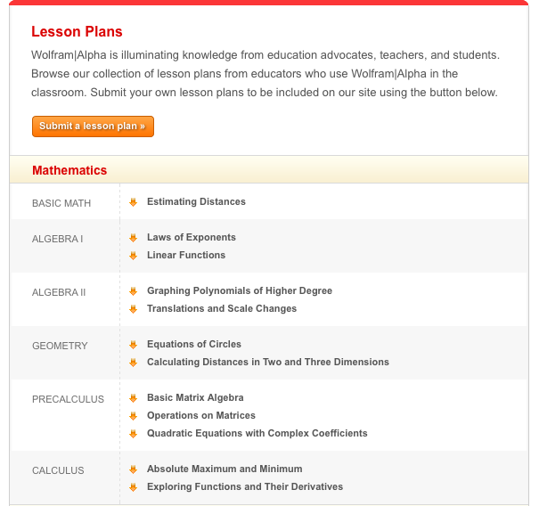
Wolfram|Alpha for Education www.wolframalpha.com/educators
Use a query, series of queries, or widgets to drive student inquiry, explore relationships between variables, and bring a lesson to life!

Slide 11
Wolfram|Alpha Resources
Wolfram|Alpha for Education
http://www.wolframalpha.com/educators/
Wolfram|Alpha Widget Builder
http://developer.wolframalpha.com/widgets/
Wolfram|Alpha Examples Page
http://www.wolframalpha.com/examples/
Thank you for participating!
Holland Lincoln
Mgr of Education
holland@wolframalpha.com

